Slide 1
Basic Macro Programming

Slide 2
Training Contents
Lesson 1: About Macro
Create a Macro
Excel Macro Recorder
Lesson 2: Macro Basics
Visual Basic Editor
Macro Comments
Messagebox
Macro Errors
Debug Macros
Workbooks and Worksheets
Application Object
Lesson 3: Macro Programming
Variables
String Manipulation

Slide 3
Training Contents
Variables
String Manipulation
Calculation
If – Then Statement
Cells
Loop
Logical Operators
Range
Array
Function and Sub
Lesson 4: Macro Controls
Textbox
Listbox
Combobox
Checkbox
Option Buttons
Userform

Slide 4
Lesson 1: About Macro
This section is for Excel users with no knowledge of Excel VBA.
Excel VBA, which stands for Excel Visual Basic for Applications, is the name of the programming language of Microsoft Excel.
With Excel VBA you can automate a task in Excel by writing a so called Macro.
This can save you a lot of time! More importantly there are certain things you cannot do with Excel alone.
Excel VBA allows you to do these things in Excel.

Slide 5
Lesson 1: About Macro
Create a Macro
To create a macro in Excel 2007, you have to turn on the Developer tab. Next, you can create a macro which will be executed after clicking on a command button.
Turn on the Developer Tab
If ever there is no Developer Tab in your Toolbar.
1. Click on the Office button in the upper left corner of your screen.
2. Click on Excel Options. The Excel Options dialog box appears.
3. Check Show Developer tab in the Ribbon.
4. Click Ok.

Slide 6
Lesson 1: About Macro
Create a Macro
To create a macro in Excel 2007, you have to turn on the Developer tab. Next, you can create a macro which will be executed after clicking on a command button.
Create a Command Button
You can now click on the Developer tab which has been placed next to the View tab.
1. Click on Insert.
2. Click on Command Button in the ActiveX Controls section.
3. Now you can drag a command button on your worksheet.

Slide 7
Lesson 1: About Macro
Create a Macro
To create a macro in Excel 2007, you have to turn on the Developer tab. Next, you can create a macro which will be executed after clicking on a command button.
Create and assign the Macro
Now it is time to create a macro (a piece of code) and assign it to the command button.
1. Right click on CommandButton1.
2. Click on View Code.
3. The Visual Basic Editor appears. Place you cursor between 'Private Sub CommandButton1_Click()' and 'End Sub'.
4. For example, add the following code line:
5. Close the Visual Basic Editor.
6. Before you click on CommandButton1, make sure Design Mode is deselected. You can do this by clicking on Design Mode again.
Range("A1").Value ="Hello"

Slide 8
Lesson 1: About Macro
Excel Macro Recorder
The Macro Recorder, a very useful tool included in Excel VBA, records every task you perform with Excel. This is good news if you want to automate repetitive tasks. All you have to do is record a specific task once. Next, you can execute the task over and over with the click of a button. This can save you a lot of time! The Macro Recorder is also a great help when you don't know how to program a specific task in Excel VBA. Simply open the Visual Basic Editor after recording the task to see how it can be programmed.
Record a Macro
1. Click on the Developer tab.
2. Click on Record Macro.
3. Record Macro window will appear.

Slide 9
Lesson 1: About Macro
Excel Macro Recorder
The Macro Recorder, a very useful tool included in Excel VBA, records every task you perform with Excel. This is good news if you want to automate repetitive tasks. All you have to do is record a specific task once. Next, you can execute the task over and over with the click of a button. This can save you a lot of time! The Macro Recorder is also a great help when you don't know how to program a specific task in Excel VBA. Simply open the Visual Basic Editor after recording the task to see how it can be programmed.
Record a Macro
Here you can give your macro a name and you can enter a shortcut for your macro (both optional). You can store your macro in three workbooks. First, Personal Macro Workbook, the macro will be available to all your workbooks (Excel Files). This is because Excel stores your macro in a hidden workbook that opens automatically when Excel starts. Second, New Workbook, the macro will only be available in an automatically new opened workbook and Last, This Workbook, the macro will only be available in the current workbook.

Slide 10
Lesson 1: About Macro
Excel Macro Recorder
The Macro Recorder, a very useful tool included in Excel VBA, records every task you perform with Excel. This is good news if you want to automate repetitive tasks. All you have to do is record a specific task once. Next, you can execute the task over and over with the click of a button. This can save you a lot of time! The Macro Recorder is also a great help when you don't know how to program a specific task in Excel VBA. Simply open the Visual Basic Editor after recording the task to see how it can be programmed.
Record a Macro
We will now record a macro that changes the format of Cells to Percentage.
4. Click on Ok
5. Right mouse click on the active cell (selected cell). Be sure not to select any other cell! Then click on Format Cells
6. Choose Percentage and click on OK.
7. Finally, Click on Stop Recording.

Slide 11
Lesson 1: About Macro
Excel Macro Recorder
The Macro Recorder, a very useful tool included in Excel VBA, records every task you perform with Excel. This is good news if you want to automate repetitive tasks. All you have to do is record a specific task once. Next, you can execute the task over and over with the click of a button. This can save you a lot of time! The Macro Recorder is also a great help when you don't know how to program a specific task in Excel VBA. Simply open the Visual Basic Editor after recording the task to see how it can be programmed.
Run a Recorded a Macro
1. Enter some numbers between 0 and 1 in Excel. Select the numbers.
2. Click on the Developer tab.
3. Click on Macros.
4. Click on Run.
Result: The format of the cells should change to Percentage Format.

Slide 12
Lesson 1: About Macro
Excel Macro Recorder
The Macro Recorder, a very useful tool included in Excel VBA, records every task you perform with Excel. This is good news if you want to automate repetitive tasks. All you have to do is record a specific task once. Next, you can execute the task over and over with the click of a button. This can save you a lot of time! The Macro Recorder is also a great help when you don't know how to program a specific task in Excel VBA. Simply open the Visual Basic Editor after recording the task to see how it can be programmed.
Edit the Macro
There are two ways to take a look at the just-recorded macro in the Visual Basic Editor.
1. Click on Macros from the Developer tab and then click on Edit.
2. Click on Visual Basic from the Developer tab or press Alt + F11.

Slide 13
Lesson 1: About Macro
Excel Macro Recorder
The Macro Recorder, a very useful tool included in Excel VBA, records every task you perform with Excel. This is good news if you want to automate repetitive tasks. All you have to do is record a specific task once. Next, you can execute the task over and over with the click of a button. This can save you a lot of time! The Macro Recorder is also a great help when you don't know how to program a specific task in Excel VBA. Simply open the Visual Basic Editor after recording the task to see how it can be programmed.
Edit the Macro
Our macro has been placed into a module called Module1. Code placed into a module is available to the whole workbook, while code placed on a sheet is only available for that particular sheet.

Slide 14
Activity 1:
Creating a Macro
Create a macro that will display the ff information about you:
Cell A1 – Complete name
Cel l A2 – Current Address
Cell A3 – Birthdate
Cell A4 – Favorite Food
Recording a Macro
Record a Macro that changes the format of cell to Currency using the Philippine Peso format (PHP 100.00).

Slide 15
Lesson 2: Macro Basics
This section explains the basics of Excel Visual Basic.
It is good to know the basic terminology explained in this section before you start programming in Excel Visual Basic.

Slide 16
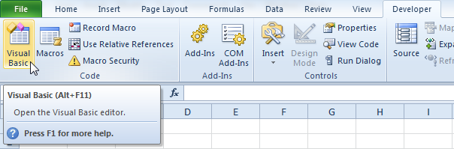
Lesson 2: Macro Basics
Visual Basic Editor
To launch the Visual Basic Editor in Excel 2010 or Excel 2007, click on Visual Basic or press Alt+F11.

Slide 17
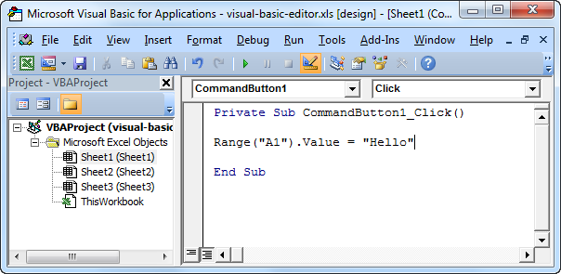
Lesson 2: Macro Basics
Visual Basic Editor
The Visual Basic Editor appears:
The left window with the sheet names in it is called the Project Explorer. If you can't see the Project Explorer, click on View and then Project Explorer. Most probably the Project Explorer will already appear as a column on the left side of the screen. If not, execute the following three steps to achieve this.

Slide 18
Lesson 2: Macro Basics
Visual Basic Editor
1. Right click on the Project Explorer.
2. Check Dockable (if necessary).
3. Click on Project - VBAProject and drag the Project Explorer to the left side of the screen.
The Code window can be added by clicking on one of the sheet names. To cover the whole screen, you can maximize the Code Window.

Slide 19
Lesson 2: Macro Basics
Macro Comments
A macro comment is a piece of text in a macro which will not be executed by Excel VBA. It is only there to provide you information about the macro. To let Excel VBA know that it is a comment, place an apostrophe at the start of the text. Execute the following steps to place a comment.
1. Launch the Visual Basic Editor.
2. Insert the line: 'Place the word Hello into cell A1' before the code line. After the line is inserted, Excel VBA colors the line green to indicate that it is a comment.
It is good practice to use comments. Macro comments become more useful as program size increases.

Slide 20
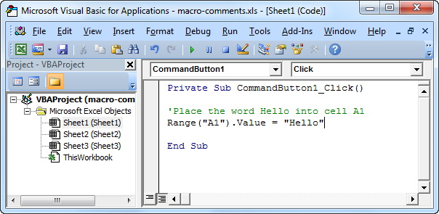
Lesson 2: Macro Basics
Macro Comments
A macro comment is a piece of text in a macro which will not be executed by Excel VBA. It is only there to provide you information about the macro. To let Excel VBA know that it is a comment, place an apostrophe at the start of the text. Execute the following steps to place a comment.

Slide 21
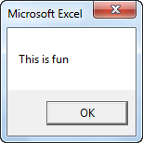
Lesson 2: Macro Basics
Messagebox
The Excel VBA MsgBox (message box) is a dialog box you can use in Excel VBA to display information to the users of your program. Below you can find three easy examples on how to create a MsgBox in Excel VBA.
1. To show a MsgBox with the message "This is fun", place a command button on your worksheet and simply add the following code line:
MsgBox “This is fun.”
Result when you click the command button on the sheet:

Slide 22
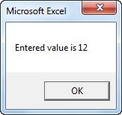
Lesson 2: Macro Basics
Messagebox
The Excel VBA MsgBox (message box) is a dialog box you can use in Excel VBA to display information to the users of your program. Below you can find three easy examples on how to create a MsgBox in Excel VBA.
2. Now we try to create a little more advanced MsgBox.
Enter a random number into cell A1.
Instead of "This is Fun", add the following code line:
MsgBox "Entered value is " & Range("A1").Value
Result when you click the command button on the sheet:
We used the & operator to concatenate (join) two strings. Although Range("A1").value is not a string, it works here.

Slide 23
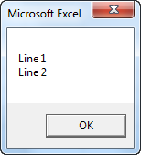
Lesson 2: Macro Basics
Messagebox
The Excel VBA MsgBox (message box) is a dialog box you can use in Excel VBA to display information to the users of your program. Below you can find three easy examples on how to create a MsgBox in Excel VBA.
3. To start a new line in a message box, you can use vbNewLine. Add the following code line:
MsgBox "Line 1" & vbNewLine & "Line 2"
Result when you click the command button on the sheet:

Slide 24
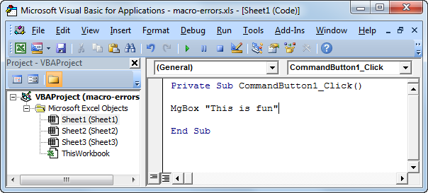
Lesson 2: Macro Basics
Macro Errors
Unfortunately, not everything goes right the first time. Excel VBA will sometimes give you a macro error saying that something isn't programmed correctly. There are too many Excel Visual Basic errors to explain them all at this stage. However, here is a good tip to deal with errors.
First, we want to create a macro error.
1. Place a command button on your worksheet and add the following incorrect code line:
MgBox "This is fun"
(instead of the correct line MsgBox "This is fun")

Slide 25
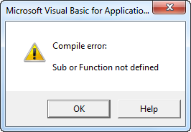
Lesson 2: Macro Basics
Macro Errors
Unfortunately, not everything goes right the first time. Excel VBA will sometimes give you a macro error saying that something isn't programmed correctly. There are too many Excel Visual Basic errors to explain them all at this stage. However, here is a good tip to deal with errors.
2. Click the command button on the sheet.
Result:

Slide 26
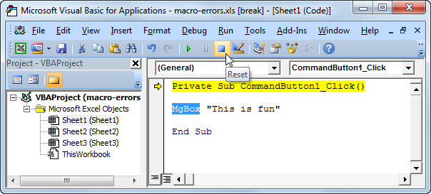
Lesson 2: Macro Basics
Macro Errors
Unfortunately, not everything goes right the first time. Excel VBA will sometimes give you a macro error saying that something isn't programmed correctly. There are too many Excel Visual Basic errors to explain them all at this stage. However, here is a good tip to deal with errors.
3. Click on Ok.
4. Next, in the Visual Basic Editor, click on Reset to stop the debugger! (More about the debugger in the next chapter) Now change the code. Excel VBA has colored the word MgBox blue to indicate the macro error.

Slide 27
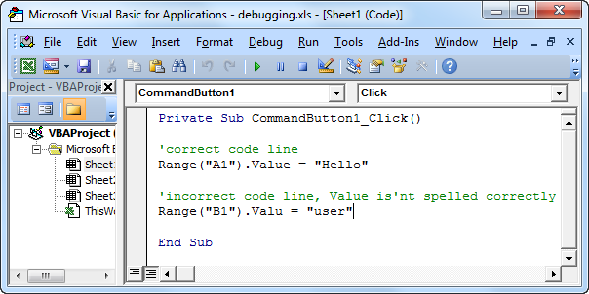
Lesson 2: Macro Basics
Debug Macros
You may have heard of the technique called debugging before. With this technique you can find errors in your Excel VBA code before you execute the code. To show you how to debug a macro, execute the following steps.
1. Launch the Visual Basic Editor.
2. Create the following incorrect macro:

Slide 28
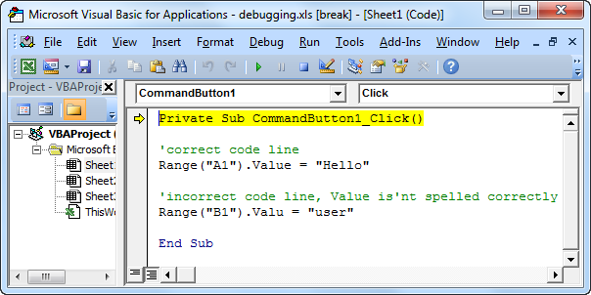
Lesson 2: Macro Basics
Debug Macros
You may have heard of the technique called debugging before. With this technique you can find errors in your Excel VBA code before you execute the code. To show you how to debug a macro, execute the following steps.
3. Place your cursor before Private.
4. There are two ways to debug a macro. Either press F8 or choose Debug from the Menu and then Step Into. Debug your macro. The first line will turn yellow.

Slide 29
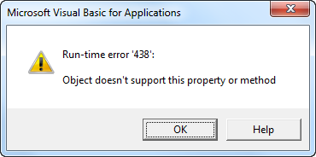
Lesson 2: Macro Basics
Debug Macros
You may have heard of the technique called debugging before. With this technique you can find errors in your Excel VBA code before you execute the code. To show you how to debug a macro, execute the following steps.
5. Press F8 again. The second code line will turn yellow. As long as the debugger thinks everything is okay, nothing will happen.
6. Press F8 twice. The following error will show up.

Slide 30
Lesson 2: Macro Basics
Debug Macros
You may have heard of the technique called debugging before. With this technique you can find errors in your Excel VBA code before you execute the code. To show you how to debug a macro, execute the following steps.
7. It says that the object doesn't support the property or method. The Range object has a property called Value. Value isn't spelled correctly here, so the debugger doesn't recognize the property. More about objects, properties and methods in the Object, Properties and Methods chapter. You may find debugging a lot of work at this stage, but it will definitely pay off once your programs become more complicated.

Slide 31
Lesson 2: Macro Basics
Workbooks and Worksheets
Now that you have seen the Range object, you can understand the Workbook and Worksheet object better. In Excel Visual Basic each object can contain another object, and that object can contain another object, etc. In other words, Excel VBA programming involves working with an object hierarchy. This probably sounds quite confusing, but i will make it clear.
The mother of all objects is Excel itself. We call it the Application object. The application object contains other objects. An example of an object of the Application object is the Workbook object (Excel File). This can be any workbook you have created. The Workbook object contains other objects, such as the Worksheet object. The Worksheet object contains other objects, such as the Range object.

Slide 32
Lesson 2: Macro Basics
Workbooks and Worksheets
We have used the following code line a lot:
but what we really meant was cell A1 on the first worksheet of Book1. Thus we should actually add the following line in Excel VBA:
Fortunately we do not have to add a code line this way. This is because Excel Visual Basic knew we meant Book1 and the first worksheet because we placed our command button there (remember?). Now also remember the automatically created module when we recorded a macro with the Excel Macro Recorder. Code placed into a module is available to all workbooks and worksheets.
Range("A1").Value
Application.Workbooks("Book1").Worksheets(1).Range("A1").Value

Slide 33
Lesson 2: Macro Basics
Workbooks and Worksheets
Fortunately we do not have to add a code line this way. This is because Excel Visual Basic knew we meant Book1 and the first worksheet because we placed our command button there (remember?). Now also remember the automatically created module when we recorded a macro with the Excel Macro Recorder. Code placed into a module is available to all workbooks and worksheets.
Place the Sub test into a module (In the Visual Basic Editor, click on Insert and then Module).
Sub test() Range("A1").Value = "code placed here" End Sub

Slide 34
Lesson 2: Macro Basics
Workbooks and Worksheets
1. Execute the code (Click on Macros and then Run, or click on Run from the Visual Basic Editor). The words "code placed here" will be placed into cell A1. No surprise.
2. Now go to the second worksheet. Execute the code again. You will see that the words will be placed on the second worksheet as well!
3. Now even open a new workbook and execute the macro again. You will see that the words will be placed there as well! That is because we didn't specify a workbook or worksheet name and Excel VBA automatically takes the active workbook and active worksheet. Be aware that if you want to change different things on different sheets to include the Worksheet object.

Slide 35
Lesson 2: Macro Basics
Workbooks and Worksheets
You may have noticed that worksheets and workbooks are both plural (see the complete code line mentioned earlier). That's because they are actually collections. The Workbooks collection contains all the Workbook objects that are currently open. The Worksheets collection contains all the Worksheet objects in a workbook.
You can refer to a member of the collection, that is: a single workbook or single worksheet, in two ways. Using the index number, Worksheets(1) is the first worksheet starting from the left. Using the member's name: Worksheets("sheet1").
It probably doesn't surprise you that the collections and the members of the collections have properties and methods as well. Here are some examples.

Slide 36
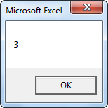
Lesson 2: Macro Basics
Workbooks and Worksheets
1. The Count property of the Worksheets collection and Workbooks collection. The following code line counts the number of worksheets of a workbook. Place a command button on your worksheet and add the code line:
Result when you click the command button on the sheet:
MsgBox Worksheets.Count
You can also use the Count property to count the number of active workbooks.

Slide 37
Lesson 2: Macro Basics
Workbooks and Worksheets
2. The Add method of the Workbooks collection and Worksheets collection. The following code line creates a new worksheet.
Worksheets.Add
You can also use the Add method to add a new workbook.
3. The Worksheet object contains more interesting collections, such as the Rows collection. In Excel VBA you can use the Select method to select a row. The code line below selects row 2.
Worksheets(1).Rows(2).Select
In a similar way, you can select a column. The code line below selects column 7.
Worksheets(1).Columns(7).Select

Slide 38
Lesson 2: Macro Basics
Application Object
The mother of all objects is Excel itself. We call it the Application object. The application object gives access to a lot of Excel related options.
You can access almost any Excel function through the Application object.
1. For example, place a command button on your worksheet and add the following code line:
Range("A3").Value = Application.WorksheetFunction.Average(Range("A1:A2"))
When you click the command button on the worksheet, Excel VBA calculates the average of the values in Cell A1 and Cell A2 and places the result into cell A3.

Slide 39
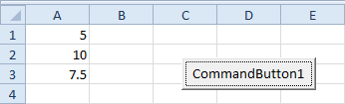
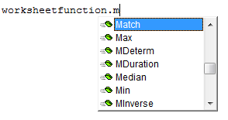
Lesson 2: Macro Basics
Application Object
Note: instead of Application.WorksheetFunction.Average, you can also just use WorksheetFunction.Average.
There are many more worksheet functions you can use in Excel VBA. Want to see more?
1. Launch the Visual Basic Editor.
2. Type in: worksheetfunction.
3. A list will appear showing you all the worksheet functions available.

Slide 40
Lesson 3: Macro Programming
This section is for users who want to get the most out of Excel VBA.
Excel VBA Programming is not difficult, but you do need to know the keywords used in Excel VBA.

Slide 41
Lesson 3: Macro Programming
Variables
This chapter teaches you how to declare, initialize and display an Excel VBA variable.
A variable is used to store a value. A variable can be of any type.
In Excel VBA, we have variables of type:
1. Integer to store whole numbers.
2. Double which can also store numbers after the comma.
3. String to store text.
4. Boolean to hold the value True or False.
5. Date to store dates.

Slide 42
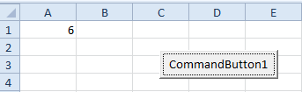
Lesson 3: Macro Programming
Variables
Place a command button on your worksheet and add the code lines described in this chapter. To execute the code lines, click the command button on the sheet.
1. Variable of type Integer
Code:
Dim x As Integer
x = 6
Range("A1").Value = x
Result:

Slide 43
Lesson 3: Macro Programming
Variables
Place a command button on your worksheet and add the code lines described in this chapter. To execute the code lines, click the command button on the sheet.
1. Variable of type Integer
a. The first code line 'Dim x As Integer' declares an Excel VBA variable with name x of type Integer. Letting Excel VBA know we are using a variable is called declaring a variable.
b. Next, we initialize the variable. In Excel VBA (and in many other programming languages), initializing simply means assigning a beginning (initial) value to a variable. This is done by adding the line 'x =6'.
c. Finally, we place the value assigned to the variable x into cell A1. This can be done by adding the line: 'Range("A1").Value = x'.

Slide 44
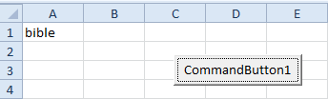
Lesson 3: Macro Programming
Variables
Place a command button on your worksheet and add the code lines described in this chapter. To execute the code lines, click the command button on the sheet.
2. Variable of type String
Code:
Dim book As String
book = "bible"
Range("A1").Value = book
Result:

Slide 45
Lesson 3: Macro Programming
Variables
Place a command button on your worksheet and add the code lines described in this chapter. To execute the code lines, click the command button on the sheet.
2. Variable of type String
a. The first code line 'Dim book As String' declares an Excel VBA variable with name book of type String.
b. Next, we initialize the variable. For example, add the line: book = "bible". Always use apostrophes to initialize String variables.
c. Finally, we place the text assigned to the variable book into cell A1. You can achieve this by adding the line 'Range("A1").Value = book'

Slide 46
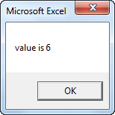
Lesson 3: Macro Programming
Variables
Place a command button on your worksheet and add the code lines described in this chapter. To execute the code lines, click the command button on the sheet.
3. Variable of type Double
Code:
Dim x As Integer
x = 5.5
MsgBox "value is " & x
Result:
But that is not the right value! We initialized the variable with value 5.5 and we get the value 6. What we need is a variable of type Double.

Slide 47
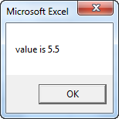
Lesson 3: Macro Programming
Variables
Place a command button on your worksheet and add the code lines described in this chapter. To execute the code lines, click the command button on the sheet.
3. Variable of type Double
Code:
Dim x As Double
x = 5.5
MsgBox "value is " & x
Result:
Note: You might wonder why you would use Integer variables, if you could use the more accurate Double variables. That is because Double variables, and even more accurate variables, need more space and as a result your code will run slower (as program size increases). Apart from this, you will see that errors are easier to find when you use variables of the right type.

Slide 48
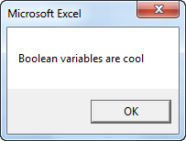
Lesson 3: Macro Programming
Variables
Place a command button on your worksheet and add the code lines described in this chapter. To execute the code lines, click the command button on the sheet.
4. Variable of type Boolean
Code:
Dim continue As Boolean continue = True If continue = True Then MsgBox "Boolean variables are cool"
Result:

Slide 49
Lesson 3: Macro Programming
Variables
Place a command button on your worksheet and add the code lines described in this chapter. To execute the code lines, click the command button on the sheet.
4. Variable of type Boolean
a. The first code line declares a variable of type Boolean.
b. Next, we initialize the Boolean variable with value True.
c. Finally, we can use the Boolean variable to only display a MsgBox if the variable holds the value True.

Slide 50
Lesson 3: Macro Programming
Variables
Place a command button on your worksheet and add the code lines described in this chapter. To execute the code lines, click the command button on the sheet.
4. Variable of type Date
Dates and times in Excel VBA can be manipulated in many ways. This chapter teaches you how to get the year, month and day of an Excel VBA date, how to add a number of days to a date, how to get the current date and time, how to get the hour, minute and second of the current time and how to convert a string to a time serial number.
Place a command button on your worksheet and add the code lines described in this chapter. To execute the code lines, click the command button on the sheet.

Slide 51
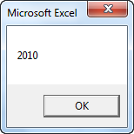
Lesson 3: Macro Programming
Variables
Place a command button on your worksheet and add the code lines described in this chapter. To execute the code lines, click the command button on the sheet.
4. Variable of type Date
Code:
Dim exampleDate As Date
exampleDate = DateValue("Jun 19, 2010") MsgBox Year(exampleDate)
Result:
Note: Use Month and Day to get the month and day of a date.

Slide 52
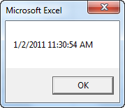
Lesson 3: Macro Programming
Variables
Place a command button on your worksheet and add the code lines described in this chapter. To execute the code lines, click the command button on the sheet.
4. Variable of type Date
Code:
MsgBox Now
Result:

Slide 53
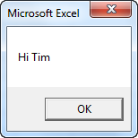
Lesson 3: Macro Programming
String Manipulation
There are many functions in Excel VBA we can use to manipulate strings. Below you can find a review of the most important functions.
1. Join Strings
We use the & operator to concatenate (join) strings.
Code:
Dim text1 As String, text2 As String text1 = "Hi " text2 = "Tim" MsgBox text1 & text2
Result:

Slide 54
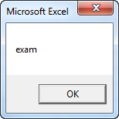
Lesson 3: Macro Programming
String Manipulation
There are many functions in Excel VBA we can use to manipulate strings. Below you can find a review of the most important functions.
2. Left
To extract the leftmost characters from a string, use Left.
Code:
Dim text As String
text = “example string" MsgBox Left(text, 4)
Result:

Slide 55
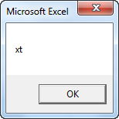
Lesson 3: Macro Programming
String Manipulation
There are many functions in Excel VBA we can use to manipulate strings. Below you can find a review of the most important functions.
3. Right
To extract the rightmost characters from a string, use Right. We can directly insert text in a function as well.
Code:
MsgBox Right("example text", 2)
Result:

Slide 56
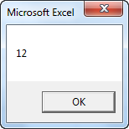
Lesson 3: Macro Programming
String Manipulation
There are many functions in Excel VBA we can use to manipulate strings. Below you can find a review of the most important functions.
4. Len
To get the length of a string, use Len.
Code:
MsgBox Len("example text")
Result:
Note: space (position 8) included!

Slide 57

Lesson 3: Macro Programming
String Manipulation
There are many functions in Excel VBA we can use to manipulate strings. Below you can find a review of the most important functions.
5. Instr
To find the position of a substring in a string, use Instr.
Code:
MsgBox Instr("example text“, “am”)
Result:
Note: string "am" found at position 3.

Slide 58
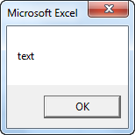
Lesson 3: Macro Programming
String Manipulation
There are many functions in Excel VBA we can use to manipulate strings. Below you can find a review of the most important functions.
6. Mid
To extract a substring, starting in the middle of a string, use Mid.
Code:
MsgBox Mid("example text“, 9, 4)
Result:
Note: started at position 9 (t) with length 4.

Slide 59
Lesson 3: Macro Programming
Calculate
Let's develop a small macro which involves a simple calculation (adding a value to a variable) and a very important programming technique.
Place a command button on your worksheet and add the following code lines:
Dim x As Integer x = Range("A1").Value x = x + 1 Range("A1").Value = x
1. The first code line declares a variable with name x of type Integer.
2. Next, we initialize this variable with the value of cell A1.

Slide 60
Lesson 3: Macro Programming
Calculate
Let's develop a small macro which involves a simple calculation (adding a value to a variable) and a very important programming technique.
3. We want to add 1 to the variable x. You can do this by adding the line 'x = x +1'. In Excel Visual Basic (and in other programming languages), the symbol '=' means becomes. It does not mean equal! So x = x + 1 means x becomes x + 1. In other words: take the present value of x and add 1 to it. Example: If x = 6, x becomes 6 + 1 = 7.
4. Finally, place the variable with the new value into cell A1.
Exit the Visual Basic Editor and enter a value into cell A1. Click on CommandButton1 to see how the value of cell A1 is incremented each time you click on CommandButton1.

Slide 61
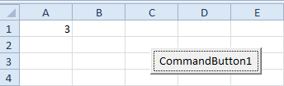
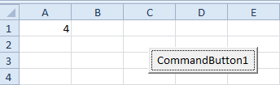

Lesson 3: Macro Programming
Calculate
Let's develop a small macro which involves a simple calculation (adding a value to a variable) and a very important programming technique.
Result:
You've just created a counter in Excel VBA. Well done!

Slide 62
Lesson 3: Macro Programming
If – Then Statement
In many situations we only want Excel VBA to execute certain code lines when a specific condition is met. The If Then statement allows you to do this. Instead of multiple If Then statements, you can use Select Case.
1. If Then statement
Dim score As Integer, grade As String score = Range("A1").Value If score >= 60 Then grade = "passed" Range("B1").Value = grade
a. The first code line declares two variables. One variable of type Integer and one variable of type String.
b. Next, we initialize the variable score with the value of cell A1.

Slide 63
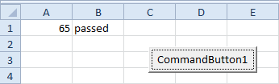
Lesson 3: Macro Programming
If – Then Statement
In many situations we only want Excel VBA to execute certain code lines when a specific condition is met. The If Then statement allows you to do this. Instead of multiple If Then statements, you can use Select Case.
1. If Then statement
c. If score is higher or equal to 60, we assign the text 'passed' to the variable grade.
d. Finally, we place the value of the variable grade into cell B1.
Exit the Visual Basic Editor, enter a value into cell A1 (should be more than 60), and click on CommandButton1.

Slide 64
Lesson 3: Macro Programming
If – Then Statement
In many situations we only want Excel VBA to execute certain code lines when a specific condition is met. The If Then statement allows you to do this. Instead of multiple If Then statements, you can use Select Case.
2. Else statement
If score is lower than 60, the previous code lines empty cell B1. We can use an Else statement to assign the text 'failed' to the variable grade if score is lower than 60.
Dim score As Integer, grade As String score = Range("A1").Value If score >= 60 Then grade = "passed" Else grade = "failed" End If Range("B1").Value = grade

Slide 65
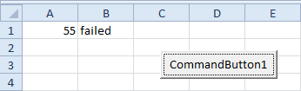
Lesson 3: Macro Programming
If – Then Statement
In many situations we only want Excel VBA to execute certain code lines when a specific condition is met. The If Then statement allows you to do this. Instead of multiple If Then statements, you can use Select Case.
2. Else statement
Result:
Note: It is good practice to always start a new line after the words Then and Else and to end with End If (see second example). Only if there is one code line after Then and no Else statement, it is allowed to place a code line directly after Then and to omit (leave out) End If (see first example).

Slide 66
Lesson 3: Macro Programming
Cells
Many beginners start their career using Cells.
For example: Cells(1,1).Select means (row 1, column 1) and is the same thing as Range("A1").Select and Cells(14,31).Select means (row 14, column 31) and is the same as Range("AE14").Select.
Note: I strongly recommend that you use Range instead of Cells to work with cells and groups of cells. It makes your sentences much clearer and you are not forced to remember that column AE is column 31.
The only time that you will use Cells is when you want to select all the cells of a worksheet.
For example: Cells.Select To select all cells and then empty all cells of values or formulas you will use: Cells.ClearContents

Slide 67
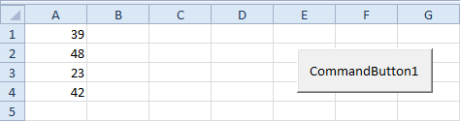
Lesson 3: Macro Programming
Loop
The Excel VBA loop (or For Next loop) is a very useful programming statement which is often used in Excel VBA. First, we will look at an easy example of how to loop through a one-dimensional range.
You can use a single loop to loop through one-dimensional range.
Place a command button on your worksheet and add the following code lines:

Slide 68
Lesson 3: Macro Programming
Loop
The Excel VBA loop (or For Next loop) is a very useful programming statement which is often used in Excel VBA. First, we will look at an easy example of how to loop through a one-dimensional range.
Dim total As Integer, i As Integer total = 0 For i = 1 To 4 'ignore the two code lines below, they are only added to illustrate the loop Cells(i, 1).Select MsgBox "i = " & i If Cells(i, 1).Value > 40 Then total = total + 1 Next i MsgBox total & " values higher than 40"

Slide 69
Lesson 3: Macro Programming
Loop
The Excel VBA loop (or For Next loop) is a very useful programming statement which is often used in Excel VBA. First, we will look at an easy example of how to loop through a one-dimensional range.
1. The first two code lines declare two variables of type Integer. One named total and one named i.
2. Next, we initialize the variable total with value 0.
3. Add the For Next loop which runs from 1 to 4.
4. Create an If Then statement which increments total by 1 if a value is higher than 40.
5. Finally, use a message box to display the total number of values higher than 40.

Slide 70
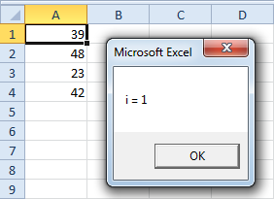
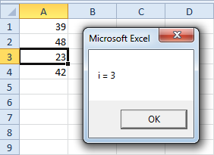
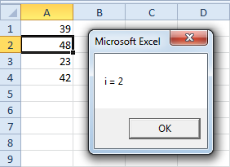
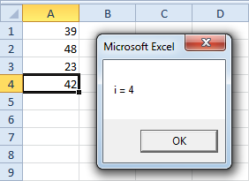
Lesson 3: Macro Programming
Loop
The Excel VBA loop (or For Next loop) is a very useful programming statement which is often used in Excel VBA. First, we will look at an easy example of how to loop through a one-dimensional range.
Result :
1.
3.
2.
4.

Slide 71
Lesson 3: Macro Programming
Loop
The Excel VBA loop (or For Next loop) is a very useful programming statement which is often used in Excel VBA. First, we will look at an easy example of how to loop through a one-dimensional range.
Explanation: The code lines between For and Next will be executed four times. For i = 1, 2, 3 and 4. For i =1, Excel VBA fills in 1 for i and gets Cells(1,1).value. This is the first value. When Excel VBA reaches Next i, it jumps back to the For statement increasing i with 1. For i = 2, Excel VBA fills in 2 for i and gets Cells(1,2).value. This is the second value. For i = 2, Excel VBA also increments total by 1 because the second value is higher than 40. For i = 3, etc.
Excel VBA loops through the code four times and after that leaves the For Next loop and executes the rest of the code.

Slide 72
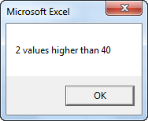
Lesson 3: Macro Programming
Loop
The Excel VBA loop (or For Next loop) is a very useful programming statement which is often used in Excel VBA. First, we will look at an easy example of how to loop through a one-dimensional range.
Result:
Note: it is good practice to always indent (tab) the code between the words For and Next. This makes your code easier to read.

Slide 73
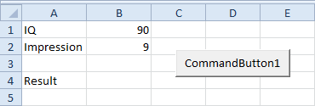
Lesson 3: Macro Programming
Logical Operators
In all sorts of macros we use Excel VBA logical operators. The three most used logical operators in Excel Visual Basic are: And, Or and Not. Each logical operator will now be illustrated with the help of an easy example.
1. Logical Operator And
For example, we hire a person for a certain job, only if his/her IQ quotient is higher or equal to 110 and the impression he or she leaves during an interview is higher or equal to 7 (on a scale of 1 to 10).

Slide 74
Lesson 3: Macro Programming
Logical Operators
In all sorts of macros we use Excel VBA logical operators. The three most used logical operators in Excel Visual Basic are: And, Or and Not. Each logical operator will now be illustrated with the help of an easy example.
1. Logical Operator And
Place a command button on your worksheet and add the following code lines:
Result when you click the command button on the sheet:
If Range("B1").Value >= 110 And Range("B2").Value >= 7 Then Range("B4").Value = "Hire" Else Range("B4").Value = "Do not hire" End If

Slide 75
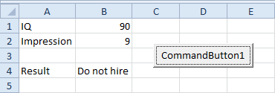
Lesson 3: Macro Programming
Logical Operators
In all sorts of macros we use Excel VBA logical operators. The three most used logical operators in Excel Visual Basic are: And, Or and Not. Each logical operator will now be illustrated with the help of an easy example.
1. Logical Operator And
Place a command button on your worksheet and add the following code lines:
The macro uses the logical operator And to get the right result. We do not hire the person because his/her IQ quotient is lower than 110.

Slide 76
Lesson 3: Macro Programming
Logical Operators
In all sorts of macros we use Excel VBA logical operators. The three most used logical operators in Excel Visual Basic are: And, Or and Not. Each logical operator will now be illustrated with the help of an easy example.
2. Logical Operator Or
For example, we hire a person for a certain job, only if his/her IQ quotient is higher or equal to 110 and the impression he or she leaves during an interview is higher or equal to 7 (on a scale of 1 to 10).
Result when you click the command button on the sheet:
If Range("B1").Value >= 110 Or Range("B2").Value >= 7 Then Range("B4").Value = "Hire" Else Range("B4").Value = "Do not hire" End If

Slide 77
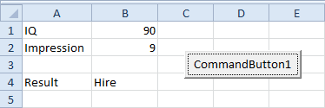
Lesson 3: Macro Programming
Logical Operators
In all sorts of macros we use Excel VBA logical operators. The three most used logical operators in Excel Visual Basic are: And, Or and Not. Each logical operator will now be illustrated with the help of an easy example.
2. Logical Operator Or
This example shows you the effect of the Or statement. Although, the IQ quotient of the person is way below 110, we hire the person because he or she leaves a very good impression during the interview.

Slide 78
Lesson 3: Macro Programming
Logical Operators
In all sorts of macros we use Excel VBA logical operators. The three most used logical operators in Excel Visual Basic are: And, Or and Not. Each logical operator will now be illustrated with the help of an easy example.
3. Logical Operator Not
For example, we do not hire a person for a certain job, who is 'greedy' and 'all about the money'. The macro below uses the logical operator Not to get the right result. The Not operator designates that the condition must not be true.
Slightly adjust the previous macro Code:
If (Range("B1").Value >= 110 Or Range("B2").Value >= 9) And Not Range("B3").Value = "Yes" Then Range("B4").Value = "Hire" Else Range("B4").Value = "Do not hire" End If

Slide 79
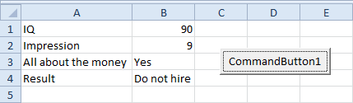
Lesson 3: Macro Programming
Logical Operators
In all sorts of macros we use Excel VBA logical operators. The three most used logical operators in Excel Visual Basic are: And, Or and Not. Each logical operator will now be illustrated with the help of an easy example.
3. Logical Operator Not
Result:
We want one of the first two conditions to be true (use brackets) and the third condition must not be true. We do not hire the person because the third condition is true (cell B3 contains the word Yes).

Slide 80
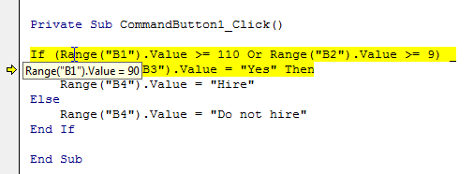
Lesson 3: Macro Programming
Logical Operators
In all sorts of macros we use Excel VBA logical operators. The three most used logical operators in Excel Visual Basic are: And, Or and Not. Each logical operator will now be illustrated with the help of an easy example.
3. Logical Operator Not
You can debug through the code using F8 (see picture below). Place the cursor on the code to see the actual values! The '_' symbol is used here to continue the statement on a new line (not necessary). Always test your macro when you use logical operators to be sure that they do what you want.

Slide 81
Lesson 3: Macro Programming
Range
This chapter gives an overview of the properties and methods of the very important Excel VBA Range object.
We have already seen the Range object in the previous chapters. The Range object is the representation of a cell (or cells) on your worksheet. The code line: 'Range("A1").value = 1' places the value 1 into cell A1. You can also execute operations in Excel Visual Basic on more than one cell at the same time. See the following three macros.
Place a command button on your worksheet and add the following code line:

Slide 82
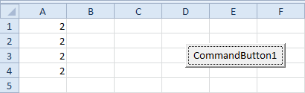
Lesson 3: Macro Programming
Range
This chapter gives an overview of the properties and methods of the very important Excel VBA Range object.
Code : (Range Examples)
Result :
Range("A1:A4").Value = 2

Slide 83
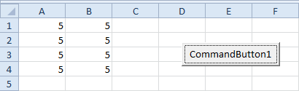
Lesson 3: Macro Programming
Range
This chapter gives an overview of the properties and methods of the very important Excel VBA Range object.
Code : (Range Examples)
Result :
Range("A1:B4").Value = 5

Slide 84
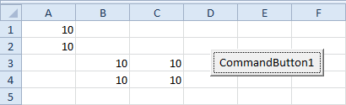
Lesson 3: Macro Programming
Range
This chapter gives an overview of the properties and methods of the very important Excel VBA Range object.
Code : (Range Examples)
Result :
Range("A1:A2,B3:C4").Value = 10

Slide 85
Lesson 3: Macro Programming
Range
This chapter gives an overview of the properties and methods of the very important Excel VBA Range object.
In the Variables chapter, we learned how to declare a variable in Excel VBA. Besides declaring a variable, you can also declare an Excel VBA Range object. You can do this by using the keywords Dim and Set.
Place a command button on your worksheet and add the following code lines:

Slide 86
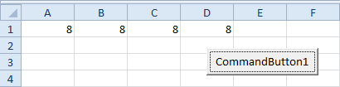
Lesson 3: Macro Programming
Range
This chapter gives an overview of the properties and methods of the very important Excel VBA Range object.
Code : (Declare a Range)
Result :
Dim example As Range Set example = Range("A1:D1") example.Value = 8

Slide 87
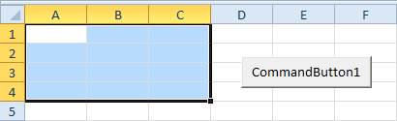
Lesson 3: Macro Programming
Range
This chapter gives an overview of the properties and methods of the very important Excel VBA Range object.
Code : (Select a Range)
Result :
Dim example As Range Set example = Range("A1:C4") example.Select

Slide 88
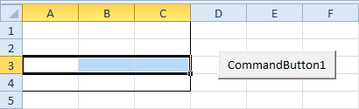
Lesson 3: Macro Programming
Range
This chapter gives an overview of the properties and methods of the very important Excel VBA Range object.
Code : (Rows)
Result : (Note: Range("A1:C4") has been formatted for illustration.)
Dim example As Range Set example = Range("A1:C4") example.Rows(3).Select

Slide 89
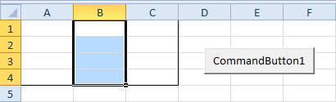
Lesson 3: Macro Programming
Range
This chapter gives an overview of the properties and methods of the very important Excel VBA Range object.
Code : (Columns)
Result : (Note: Range("A1:C4") has been formatted for illustration.)
Dim example As Range Set example = Range("A1:C4") example.Columns(2).Select

Slide 90
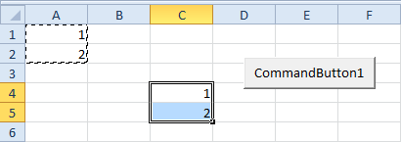
Lesson 3: Macro Programming
Range
This chapter gives an overview of the properties and methods of the very important Excel VBA Range object.
Code : (Copy & Paste)
Result :
Range("A1:A2").Select Selection.Copy Range("C4").Select ActiveSheet.Paste

Slide 91
Lesson 3: Macro Programming
Array
An Excel VBA array is a group of variables. You can refer to a specific variable (element) of an array by using the array name and the index number. To create a one-dimensional array, execute the following steps.
Place a command button on your worksheet and add the following code lines:
Dim Films(1 To 5) As String Films(1) = "Lord of the Rings" Films(2) = "Speed" Films(3) = "Star Wars" Films(4) = "The Godfather" Films(5) = "Pulp Fiction" MsgBox Films(4)

Slide 92

Lesson 3: Macro Programming
Array
An Excel VBA array is a group of variables. You can refer to a specific variable (element) of an array by using the array name and the index number. To create a one-dimensional array, execute the following steps.
1. The first code line declares a String array with name Films. The array consists of five elements.
2. Next, we initialize each element of the array. In other words: we assign beginning values.
3. Finally, we display the fourth film using a MsgBox.
Exit the Visual Basic Editor and test the array.
Result :

Slide 93
Lesson 3: Macro Programming
Function and Sub
The difference between a function and a sub in Excel VBA is that a function can return a value and a sub cannot. In this chapter we will look at an easy example of a function and a sub. Functions and subs become very useful as program size increases.
1. Function
If you want Excel VBA to perform a task that returns a result, you can use a function. Place a function into a module (In the Visual Basic Editor, click on Insert and then Module). For example, the function with name Area.
Function Area(x As Double, y As Double) As Double Area = x * y End Function

Slide 94
Lesson 3: Macro Programming
Function and Sub
The difference between a function and a sub in Excel VBA is that a function can return a value and a sub cannot. In this chapter we will look at an easy example of a function and a sub. Functions and subs become very useful as program size increases.
1. Function
Explanation: This function has two arguments (of type Double) and a return type (the part after As also of type Double). You can use the name of the function (Area) in your code to indicate which result you want to return (here x * y).
You can now refer to this function (in other words call the function) from somewhere else in your code by simply using the name of the function and giving a value for each argument.

Slide 95
Lesson 3: Macro Programming
Function and Sub
The difference between a function and a sub in Excel VBA is that a function can return a value and a sub cannot. In this chapter we will look at an easy example of a function and a sub. Functions and subs become very useful as program size increases.
1. Function
Place a command button on your worksheet and add the following code lines:
Dim z As Double z = Area(3, 5) + 2 MsgBox z

Slide 96

Lesson 3: Macro Programming
Function and Sub
The difference between a function and a sub in Excel VBA is that a function can return a value and a sub cannot. In this chapter we will look at an easy example of a function and a sub. Functions and subs become very useful as program size increases.
1. Function
Explanation: The function returns a value so you have to 'catch' this value in your code. You can use another variable (z) for this. Next, you can add another value to this variable (if you want). Finally, display the value using a MsgBox.
Result :

Slide 97
Lesson 3: Macro Programming
Function and Sub
The difference between a function and a sub in Excel VBA is that a function can return a value and a sub cannot. In this chapter we will look at an easy example of a function and a sub. Functions and subs become very useful as program size increases.
2. Sub
If you want Excel VBA to perform some actions, you can use a sub. Place a sub into a module (In the Visual Basic Editor, click on Insert and then Module). For example, the sub with name Area.
Sub Area(x As Double, y As Double) Msgbox = x * y End Sub

Slide 98
Lesson 3: Macro Programming
Function and Sub
The difference between a function and a sub in Excel VBA is that a function can return a value and a sub cannot. In this chapter we will look at an easy example of a function and a sub. Functions and subs become very useful as program size increases.
2. Sub
Explanation: This sub has two arguments (of type Double). It does not have a return type! You can refer to this sub (call the sub) from somewhere else in your code by simply using the name of the sub and giving a value for each argument.
Place a command button on your worksheet and add the following code line:
Area 3, 5

Slide 99

Lesson 3: Macro Programming
Function and Sub
The difference between a function and a sub in Excel VBA is that a function can return a value and a sub cannot. In this chapter we will look at an easy example of a function and a sub. Functions and subs become very useful as program size increases.
2. Sub
Result :
Can you see the difference between the function and the sub? The function returned the value 15. We added the value 2 to this result and displayed the final result. When we called the sub we had no more control over the result (15) because a sub cannot return a value!

Slide 100
Lesson 4: Macro Controls
This section is about communicating with users using controls or a Userform.
Learn how to use these controls in Excel 2010, Excel 2007 or Excel 2003.
You can directly place controls on a sheet or place them on a Userform.

Slide 101

Lesson 4: Macro Controls
Textbox
A textbox is an empty field where the user can fill in a piece of text. Learn how to draw a textbox on your worksheet, how to refer to a textbox in your Excel VBA code, and how to clear a textbox.
1. Draw a Textbox
Excel 2010 and Excel 2007 users. Click on Insert from the Developer tab and then click on Text Box in the ActiveX Controls section.

Slide 102

Lesson 4: Macro Controls
Textbox
A textbox is an empty field where the user can fill in a piece of text. Learn how to draw a textbox on your worksheet, how to refer to a textbox in your Excel VBA code, and how to clear a textbox.
1. Draw a Textbox
a. Draw a textbox and a command button on your worksheet.

Slide 103
Lesson 4: Macro Controls
Textbox
A textbox is an empty field where the user can fill in a piece of text. Learn how to draw a textbox on your worksheet, how to refer to a textbox in your Excel VBA code, and how to clear a textbox.
1. Draw a Textbox
b. You can change the caption of the command button by right clicking on the command button and then clicking on Properties and Caption (make sure Design Mode is selected).
c. You can change the name of the textbox by right clicking on the textbox and then clicking on Properties and Name. For now, we will leave TextBox1 as the name of the textbox.

Slide 104

Lesson 4: Macro Controls
Textbox
A textbox is an empty field where the user can fill in a piece of text. Learn how to draw a textbox on your worksheet, how to refer to a textbox in your Excel VBA code, and how to clear a textbox.
2. Populate a Textbox
a. Right click on the command button. Click on View Code. Add the following code line:
Result:
TextBox1.Text = "Data imported successfully"

Slide 105
Lesson 4: Macro Controls
Textbox
A textbox is an empty field where the user can fill in a piece of text. Learn how to draw a textbox on your worksheet, how to refer to a textbox in your Excel VBA code, and how to clear a textbox.
2. Populate a Textbox
b. To place text from a textbox into a cell, add a code line like this:
Range("A1").Value = TextBox1.Text

Slide 106
Lesson 4: Macro Controls
Textbox
A textbox is an empty field where the user can fill in a piece of text. Learn how to draw a textbox on your worksheet, how to refer to a textbox in your Excel VBA code, and how to clear a textbox.
3. Clear a Textbox
To clear a textbox, use the following code line:
Although in some situations it can be useful to directly place a textbox on your worksheet, a textbox is particularly useful when placed on a Userform
TextBox1.Value = ""

Slide 107

Lesson 4: Macro Controls
Listbox
An Excel VBA listbox, is a drop down list from where the user can make a choice. Learn how to draw a listbox on your worksheet and how to add items to a listbox.
1. Draw a Listbox
Excel 2010 and Excel 2007 users. Click on Insert from the Developer tab and then click on List Box in the ActiveX Controls section.

Slide 108

Lesson 4: Macro Controls
Listbox
An Excel VBA listbox, is a drop down list from where the user can make a choice. Learn how to draw a listbox on your worksheet and how to add items to a listbox.
1. Draw a Listbox
a. Draw a listbox on your worksheet.

Slide 109
Lesson 4: Macro Controls
Listbox
An Excel VBA listbox, is a drop down list from where the user can make a choice. Learn how to draw a listbox on your worksheet and how to add items to a listbox.
2. Add items to Listbox
a. Add the following code lines to the Workbook open event (or add them to your own code).
Note: use Sheet2 if your listbox is located on the second worksheet.
With Sheet1.ListBox1 .AddItem "Paris" .AddItem "New York" .AddItem "London" End With

Slide 110

Lesson 4: Macro Controls
Listbox
An Excel VBA listbox, is a drop down list from where the user can make a choice. Learn how to draw a listbox on your worksheet and how to add items to a listbox.
2. Add items to Listbox
Result :

Slide 111

Lesson 4: Macro Controls
Listbox
An Excel VBA listbox, is a drop down list from where the user can make a choice. Learn how to draw a listbox on your worksheet and how to add items to a listbox.
2. Add items to Listbox
b. To link a cell to the listbox, right click on the listbox (make sure design mode is selected) and click on Properties. Fill in D3 for LinkedCell.
Note: also see the ListFillRange property, to fill a listbox with a range of cells.

Slide 112

Lesson 4: Macro Controls
Listbox
An Excel VBA listbox, is a drop down list from where the user can make a choice. Learn how to draw a listbox on your worksheet and how to add items to a listbox.
2. Add items to Listbox
c. Close Excel and reopen your Excel file.
Result :

Slide 113
Lesson 4: Macro Controls
Listbox
An Excel VBA listbox, is a drop down list from where the user can make a choice. Learn how to draw a listbox on your worksheet and how to add items to a listbox.
2. Add items to Listbox
d. Note: if you use these code lines in your own code, outside the Workbook Open event, add the following code line at the start of your code.
This way your items won't be added multiple times, when you execute your code more than once.
Although in some situations it can be useful to directly place a listbox on your worksheet, a listbox is particularly useful when placed on a Userform.
ListBox1.Clear

Slide 114

Lesson 4: Macro Controls
Combobox
An Excel VBA combobox is a drop down list from where the user can make a choice. The difference between a listbox and a combobox is that with a combobox the user can also fill in his/her own choice if it is not included in the list.
1. Draw a combobox
Excel 2010 and Excel 2007 users. Click on Insert from the Developer tab and then click on Combo Box in the ActiveX Controls section.

Slide 115

Lesson 4: Macro Controls
Combobox
An Excel VBA combobox is a drop down list from where the user can make a choice. The difference between a listbox and a combobox is that with a combobox the user can also fill in his/her own choice if it is not included in the list.
1. Draw a combobox
a. Draw a combobox on your worksheet.

Slide 116
Lesson 4: Macro Controls
Combobox
An Excel VBA combobox is a drop down list from where the user can make a choice. The difference between a listbox and a combobox is that with a combobox the user can also fill in his/her own choice if it is not included in the list.
2. Add items to combobox
a. Add the following code lines to the Workbook open event (or add them to your own code).
Note: use Sheet2 if your combobox is located on the second worksheet.
With Sheet1.ComboBox1 .AddItem "Paris" .AddItem "New York" .AddItem "London" End With

Slide 117

Lesson 4: Macro Controls
Combobox
An Excel VBA combobox is a drop down list from where the user can make a choice. The difference between a listbox and a combobox is that with a combobox the user can also fill in his/her own choice if it is not included in the list.
2. Add items to combobox
Result :

Slide 118

Lesson 4: Macro Controls
Combobox
An Excel VBA combobox is a drop down list from where the user can make a choice. The difference between a listbox and a combobox is that with a combobox the user can also fill in his/her own choice if it is not included in the list.
2. Add items to combobox
b. To link a cell to the combobox, right click on the combobox (make sure design mode is selected) and click on Properties. Fill in E2 for LinkedCell.
Note: also see the ListFillRange property, to fill a combobox with a range of cells.

Slide 119

Lesson 4: Macro Controls
Combobox
An Excel VBA combobox is a drop down list from where the user can make a choice. The difference between a listbox and a combobox is that with a combobox the user can also fill in his/her own choice if it is not included in the list.
2. Add items to combobox
c. Close Excel and reopen your Excel file.
d. Choose an item from the combobox or fill in your own choice.
Result :

Slide 120
Lesson 4: Macro Controls
Combobox
An Excel VBA combobox is a drop down list from where the user can make a choice. The difference between a listbox and a combobox is that with a combobox the user can also fill in his/her own choice if it is not included in the list.
2. Add items to combobox
e. Note: if you use these code lines in your own code, outside the Workbook Open event, add the following code line at the start of your code.
This way your items won't be added multiple times, when you execute your code more than once.
ComboBox1.Clear

Slide 121
Lesson 4: Macro Controls
Combobox
An Excel VBA combobox is a drop down list from where the user can make a choice. The difference between a listbox and a combobox is that with a combobox the user can also fill in his/her own choice if it is not included in the list.
2. Add items to combobox
f. The previous code line doesn't clear your own choice. Add the following code line to achieve this.
Although in some situations it can be useful to directly place a combobox on your worksheet, a combobox is particularly useful when placed on a Userform.
ComboBox1.Value = “”

Slide 122

Lesson 4: Macro Controls
Checkbox
An Excel VBA checkbox is a field which can be checked to store information. Learn how to draw a checkbox on your worksheet and how to refer to a checkbox in your code.
1. Draw a checkbox
Excel 2010 and Excel 2007 users. Click on Insert from the Developer tab and then click on Check Box in the ActiveX Controls section.

Slide 123

Lesson 4: Macro Controls
Checkbox
An Excel VBA checkbox is a field which can be checked to store information. Learn how to draw a checkbox on your worksheet and how to refer to a checkbox in your code.
1. Draw a checkbox
a. Draw a checkbox on your worksheet.

Slide 124
Lesson 4: Macro Controls
Checkbox
An Excel VBA checkbox is a field which can be checked to store information. Learn how to draw a checkbox on your worksheet and how to refer to a checkbox in your code.
1. Draw a checkbox
a. Right click on the checkbox. Click on View Code. Add the following code lines:
c. You can change the name of the checkbox by right clicking on the checkbox and then clicking on Properties and Name. For now, we will leave Checkbox1 as the name of the checkbox.

Slide 125
Lesson 4: Macro Controls
Checkbox
An Excel VBA checkbox is a field which can be checked to store information. Learn how to draw a checkbox on your worksheet and how to refer to a checkbox in your code.
2. Refer to checkbox in your code
a. You can change the caption of the checkbox by right clicking on the checkbox and then clicking on Properties and Caption (make sure Design Mode is selected).
Private Sub CheckBox1_Click() If CheckBox1.Value = True Then Range("C2").Value = 1 If CheckBox1.Value = False Then Range("C2").Value = 0 End Sub

Slide 126


Lesson 4: Macro Controls
Checkbox
An Excel VBA checkbox is a field which can be checked to store information. Learn how to draw a checkbox on your worksheet and how to refer to a checkbox in your code.
2. Refer to checkbox in your code
b. Exit the Visual Basic Editor and check the checkbox.
Result :
Although in some situations it can be useful to directly place a checkbox on your worksheet, a checkbox is particularly useful when placed on a Userform.

Slide 127

Lesson 4: Macro Controls
Option Button
Excel VBA option buttons are the same as checkboxes except that option buttons are dependent on each other while checkboxes are not. This means that when you check one option button the other option button will automatically uncheck.
1. Draw on Option Button
Excel 2010 and Excel 2007 users. Click on Insert from the Developer tab and then click on Option Button in the ActiveX Controls section.

Slide 128

Lesson 4: Macro Controls
Option Button
Excel VBA option buttons are the same as checkboxes except that option buttons are dependent on each other while checkboxes are not. This means that when you check one option button the other option button will automatically uncheck.
1. Draw on Option Button
a. Draw two option buttons on your worksheet.

Slide 129
Lesson 4: Macro Controls
Option Button
Excel VBA option buttons are the same as checkboxes except that option buttons are dependent on each other while checkboxes are not. This means that when you check one option button the other option button will automatically uncheck.
1. Draw on Option Button
a. You can change the captions of the option buttons by right clicking on the option button and then clicking on Properties and Caption (make sure Design Mode is selected).
b. You can change the name of the option button by right clicking on the option button and then clicking on Properties and Name. For now we will leave OptionButton1 and OptionButton2 as the names of the option buttons.

Slide 130
Lesson 4: Macro Controls
Option Button
Excel VBA option buttons are the same as checkboxes except that option buttons are dependent on each other while checkboxes are not. This means that when you check one option button the other option button will automatically uncheck.
2. Refer to Option Button in your Code
a. Right click on the first option button. Click on View Code. Add the following code line:
Private Sub OptionButton1_Click() If OptionButton1.Value = True Then Range("D3").Value = 30 End Sub

Slide 131
Lesson 4: Macro Controls
Option Button
Excel VBA option buttons are the same as checkboxes except that option buttons are dependent on each other while checkboxes are not. This means that when you check one option button the other option button will automatically uncheck.
2. Refer to Option Button in your Code
b. Right click on the second option button. Click on View Code. Add the following code line:
Private Sub OptionButton2_Click() If OptionButton2.Value = True Then Range("D3").Value = 50 End Sub

Slide 132


Lesson 4: Macro Controls
Option Button
Excel VBA option buttons are the same as checkboxes except that option buttons are dependent on each other while checkboxes are not. This means that when you check one option button the other option button will automatically uncheck.
2. Refer to Option Button in your Code
c. Exit the Visual Basic Editor and click on the option buttons.
Result :
Although in some situations it can be useful to directly place option buttons on your worksheet, option buttons are particularly useful when placed on a Userform.

Slide 133

Lesson 4: Macro Controls
Userform
This chapter teaches you how to create an Excel VBA Userform also known as a dialog box.
1. Create Userform
To create a custom dialog box, you must create a UserForm. To create a UserForm, click UserForm on the Insert menu in the Visual Basic Editor.

Slide 134

Lesson 4: Macro Controls
Userform
This chapter teaches you how to create an Excel VBA Userform also known as a dialog box.
2. Sample Userform.

Slide 135

Lesson 4: Macro Controls
Userform
This chapter teaches you how to create an Excel VBA Userform also known as a dialog box.
3. Toolbox Controls.
In adding controls to userform, click any controls needed and just drop inside the userform.

Slide 136
Final Activity:
Create a macro program in Userform format and by using its controls.

